Slide 1
유비원 Hackfest 결과 보고 ‘해외 발주 정보 리스크 분석 시스템’
2017-7-4

Slide 2
개요 및 일정
해외 발주 정보 리스크 분석 시스템 Hackfest 진행의 건
일정
5/31 Hackfest Planning 시작
6/24 Hackfest 내용 및 Architecture 협의
6/27~7/3 Hackfest
참가인원
Microsoft: 김태영 부장, 성지용 부장, 김명신 부장
유비원: 이연 상무님, 김상익 상무님, 이미진 담당님

Slide 3
이연 상무님 슬라이드

Slide 4
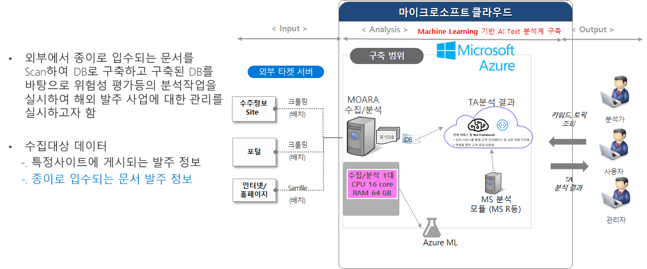
Business Requirements

Slide 5
기대효과
해외 주재원 직접 입수 또는 FAX 등으로 입수되는 해외 발주정보를 DB화 할 수 있음
종이로 입수되는 발주 정보를 사이트에 게시된 정보와 함께 DB화 하여 발주 정보에 대한 종합적인 위험성 평가를 실시 할 수 있음
Azure의 서비스를 이용함으로써 개발기간단축, 운영비용 절감 등의 효과를 도모할 수 있음
수집, 분석 대상 정보의 확대 등에 유연하게 대처할 수 있는 시스템으로 구축할 수 있음

Slide 6
Demo

Slide 7
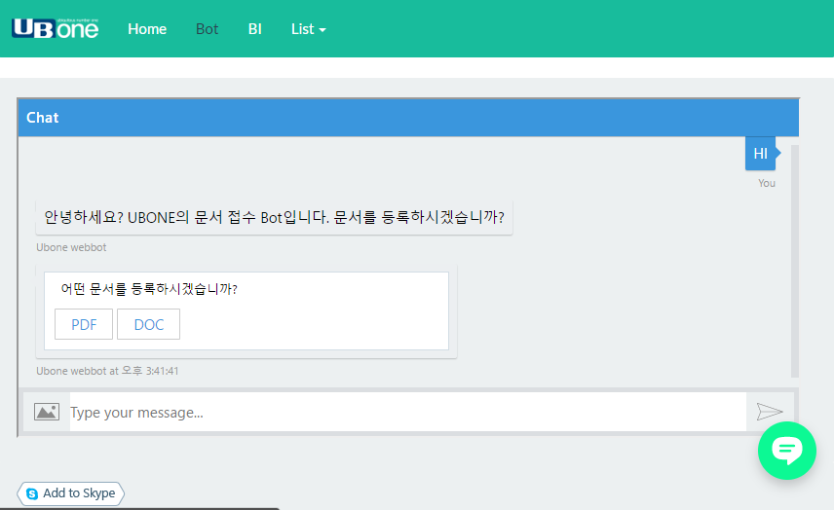
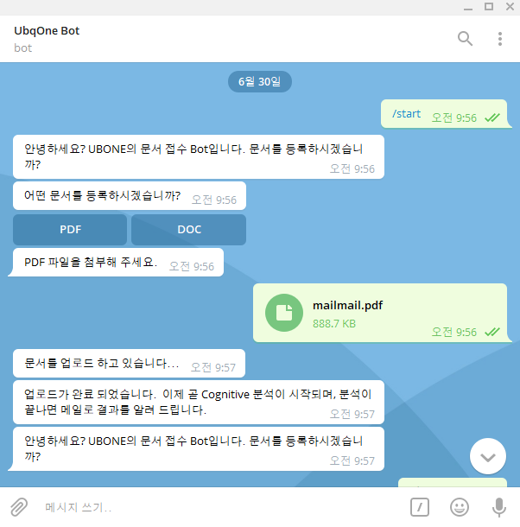
Scenario – 1. File Upload
- From Website
- From Telegram

Slide 8
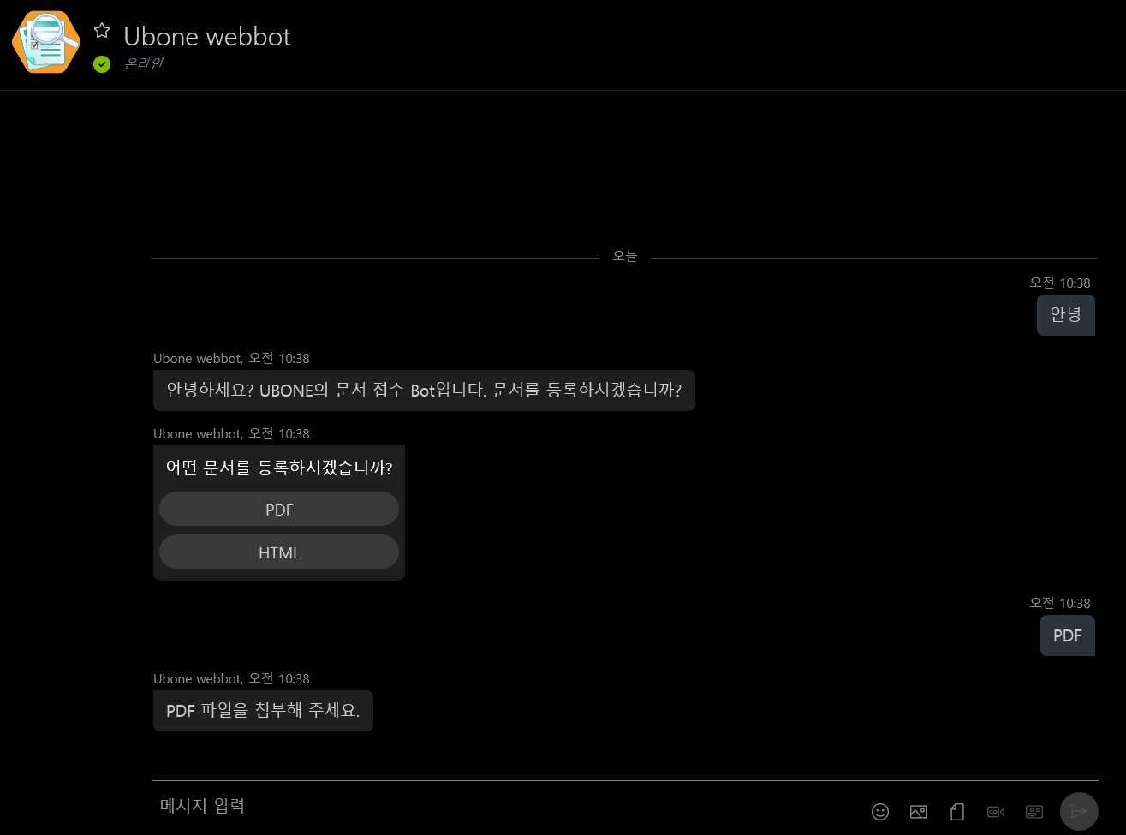
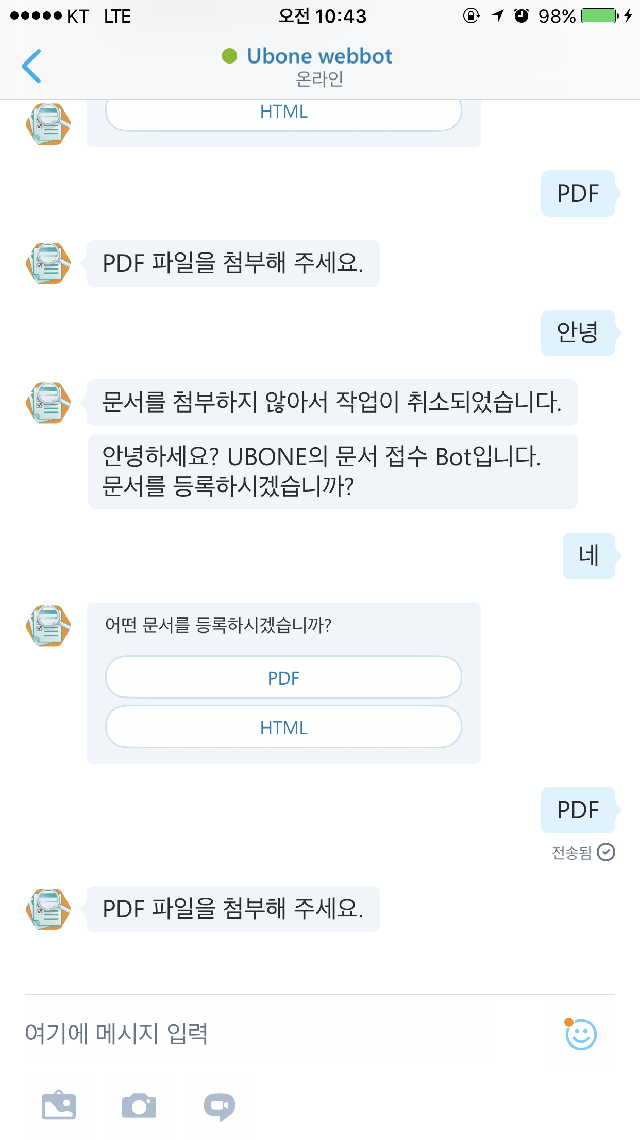
Scenario – 1. File Upload
- From Skype
- From Skype Web

Slide 9

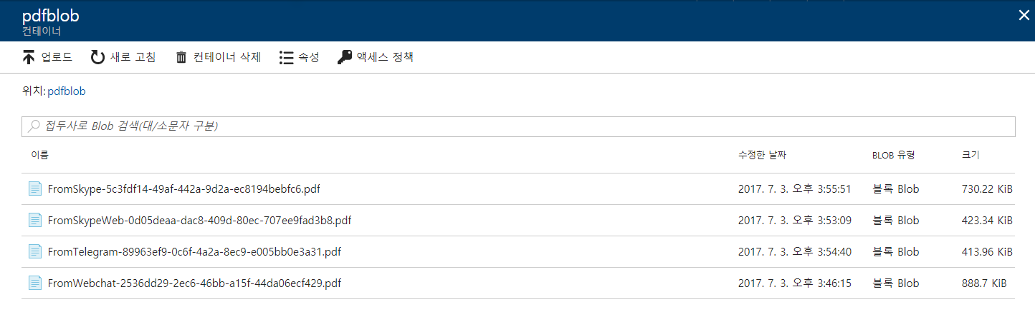
Scenario – 1. File Upload

Slide 10

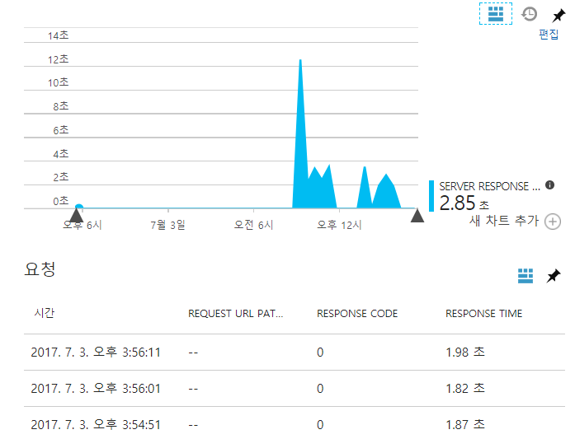


Scenario – 2. PDF to TXT
.pdf
.txt

Slide 11


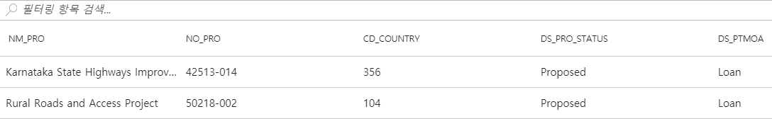
Scenario – 3. Text Analytics to Data Inserts
Text Analytics
Extract
Meaningful
Data
.txt

Slide 12


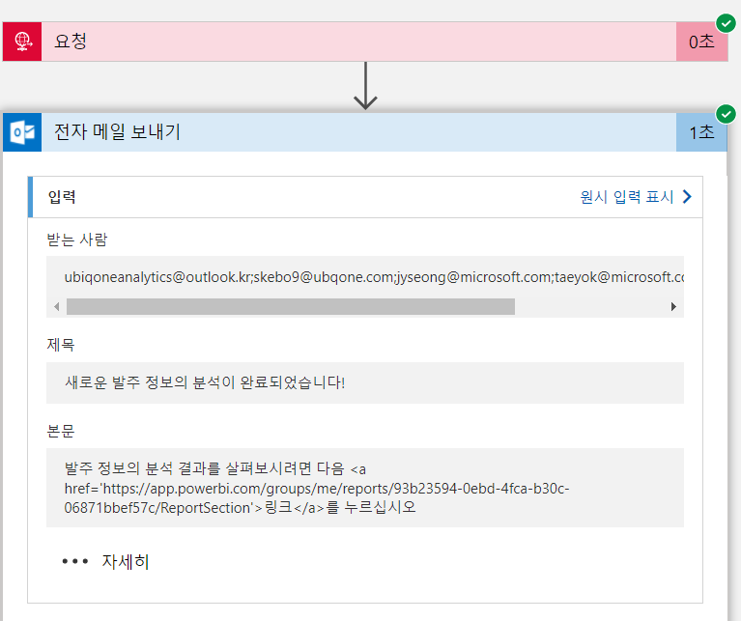
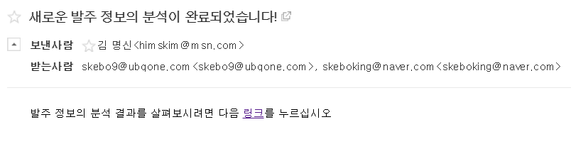
Scenario – 4. Email Notification

Slide 13
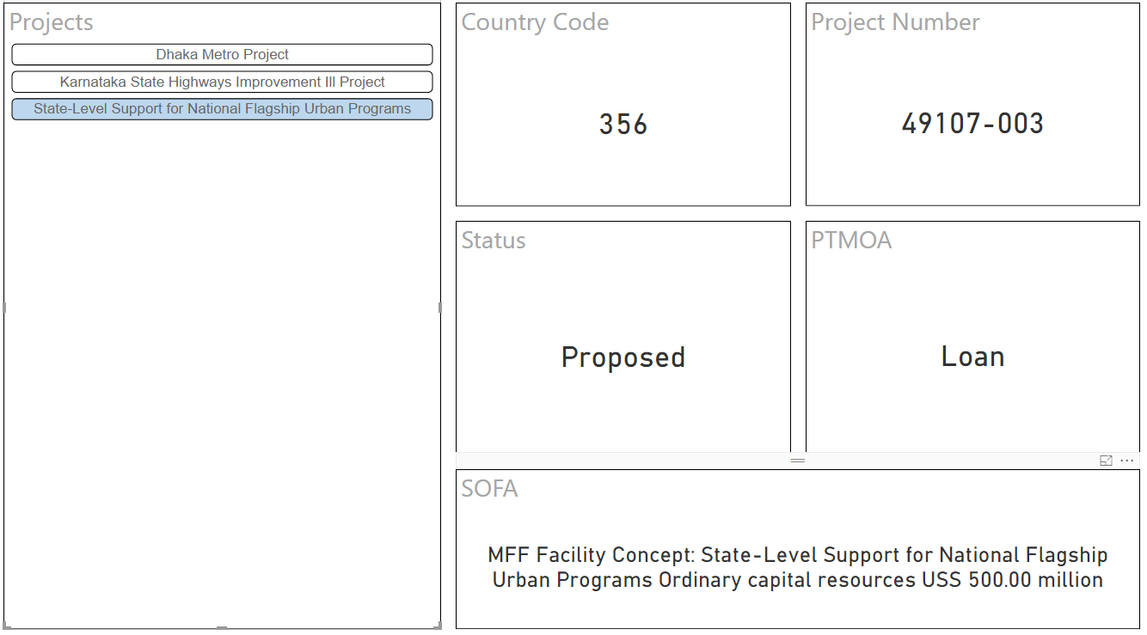
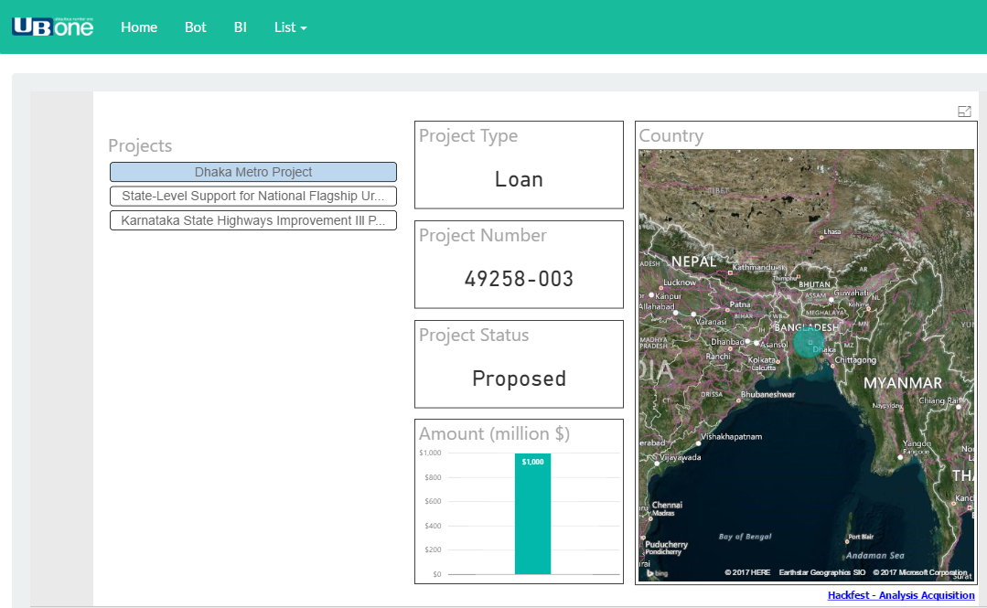
Scenario – 5. Open a Power BI Report
- Using Country Code
- Using Country Name

Slide 14
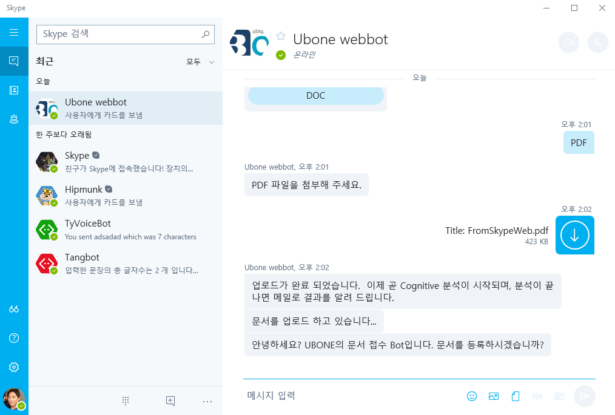
Screen-shot
http://ubone-webbot.azurewebsites.net

Slide 15
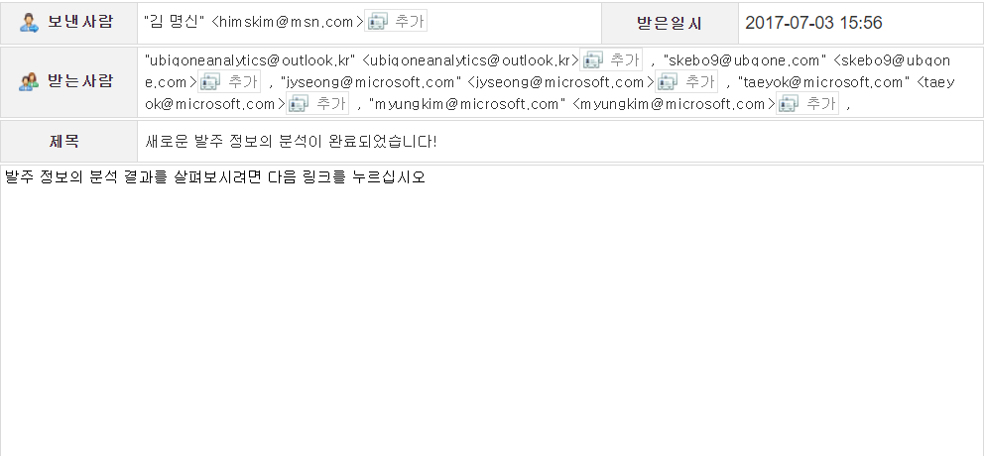
Screen-shot

Slide 16
Hackfest Development
Communication & Collaboration
Fully utilize azure platform features
Using Microsoft & open source technologies

Slide 17
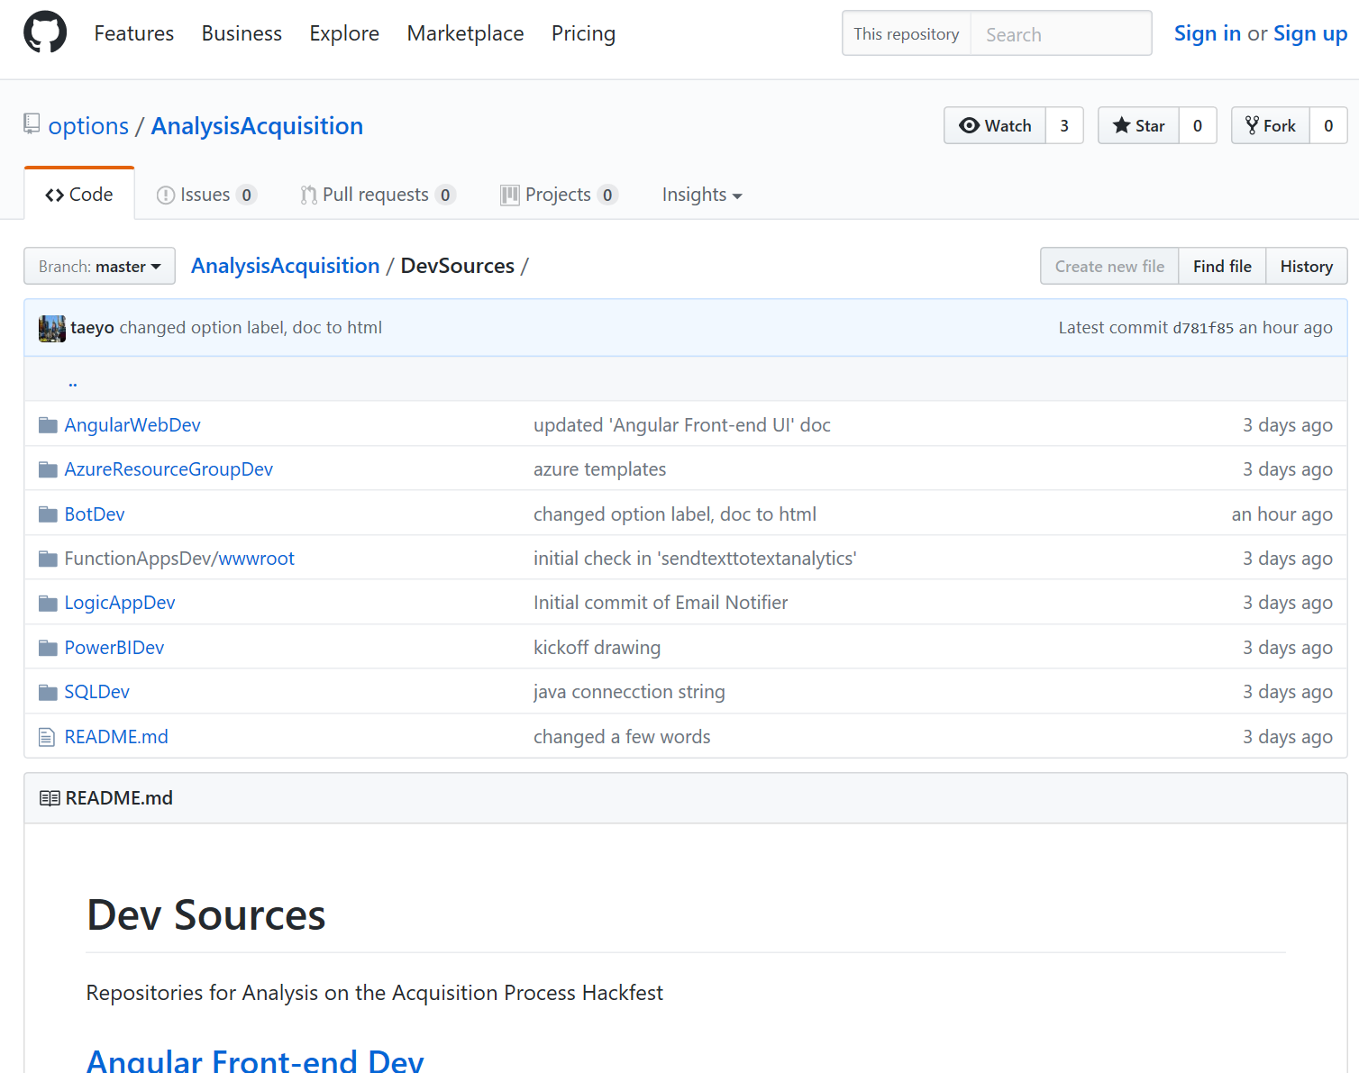
Communication & Collaboration
OneNote
Telegram
Email
OneDrive
GitHub

Slide 18
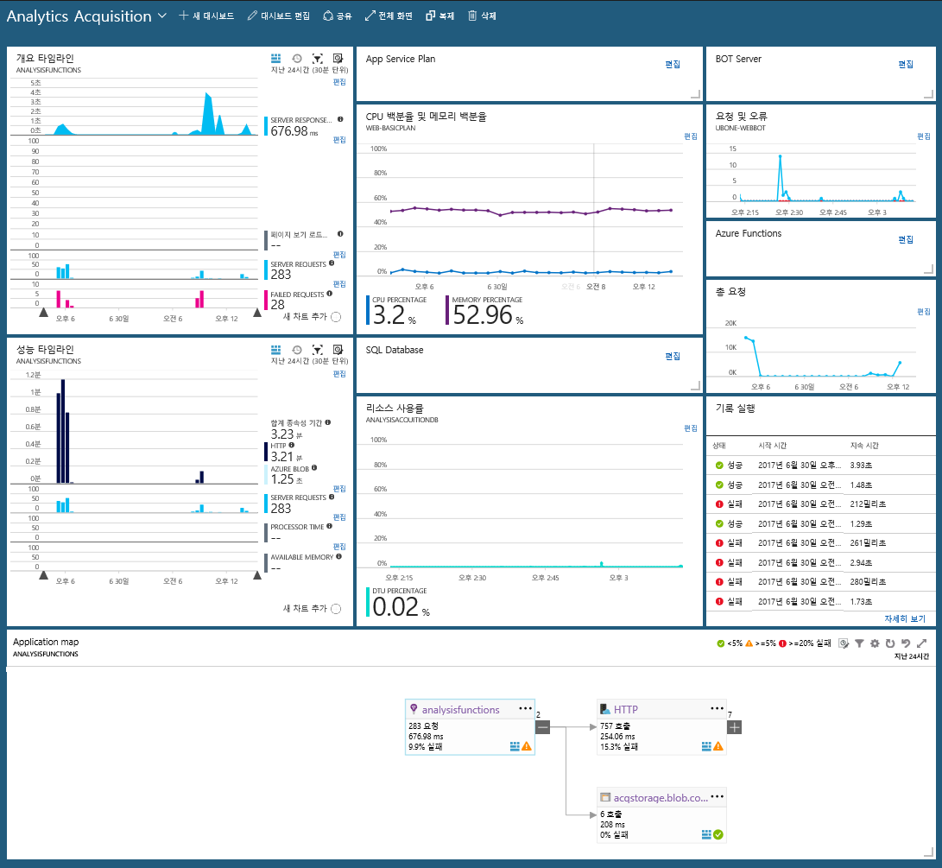
Fully utilized azure platform features
Azure WebApp
Azure Functions
Logic App
Azure Storage
SQL Database
Power BI
Cognitive Services
Application Insights
Azure Monitor

Slide 19
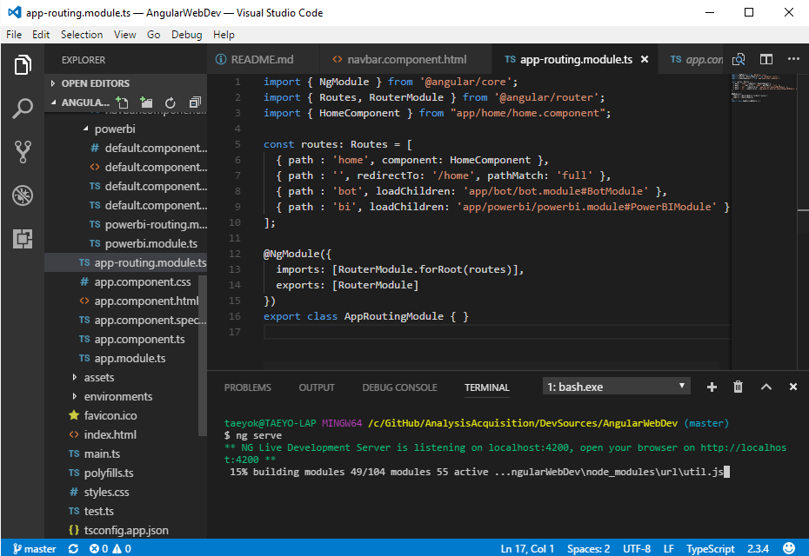
Using Microsoft & Open Source Technologies
Visual Studio (Code)
Bot Framework
Vision API
C#
PowerShell
Typescript
Angular
Bootstrap

Slide 20
Architecture
Microservices
Serverless
Reactive / Elastic
Loosely Coupled
Asynchronous IO / Messaging

Slide 21
Architecture
Frontend
Ingestion Acquisition Information using multiple channels
Backend
Optical character recognition & Spell Checking to mitigate recognition error
Analytics
Analytics Acquisition Information and Risks
Monitoring
Application Perf. Monitoring
Visualization
Visualization Analyzed Results

Slide 22












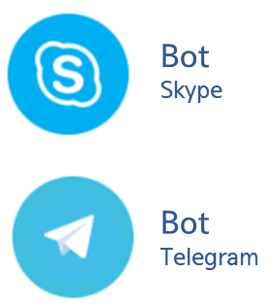




Architecture
4
5
6
PDF
Container
PDF to Text
Converter
Vision API
(OCR)
Uniqone
Web App
8
7
Text
Container
Spell
Checker
Bing Spell
Check API
9
Content
Transferring
Bot
Web Chat
10
Bot
Skype Web
2
1
3
11
12
Uniqone
Bot App
Analytics
Database
Uniqone
Text Analytics
Email
Notification
13
14
Monitoring
Dashboard
Analytics
Visualizer
APM
Trigger
Invoke/Call

Slide 23
김태영 부장님 슬라이드

Slide 24
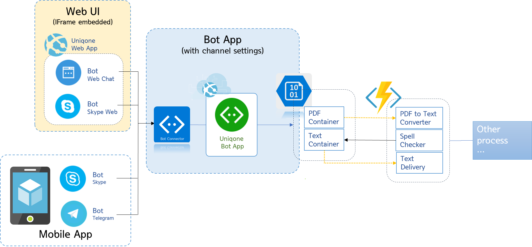
Web & Channel Client Arch.
Web Site
ubone-webbot.azurewebsites.net
Hosted on Azure Web App
Simple HTML
Chat bots embedded
Mobile App(Channels)
Skype
Telegram
Bot App
Hosted on Azure Web App
ASP.NET Web API

Slide 25
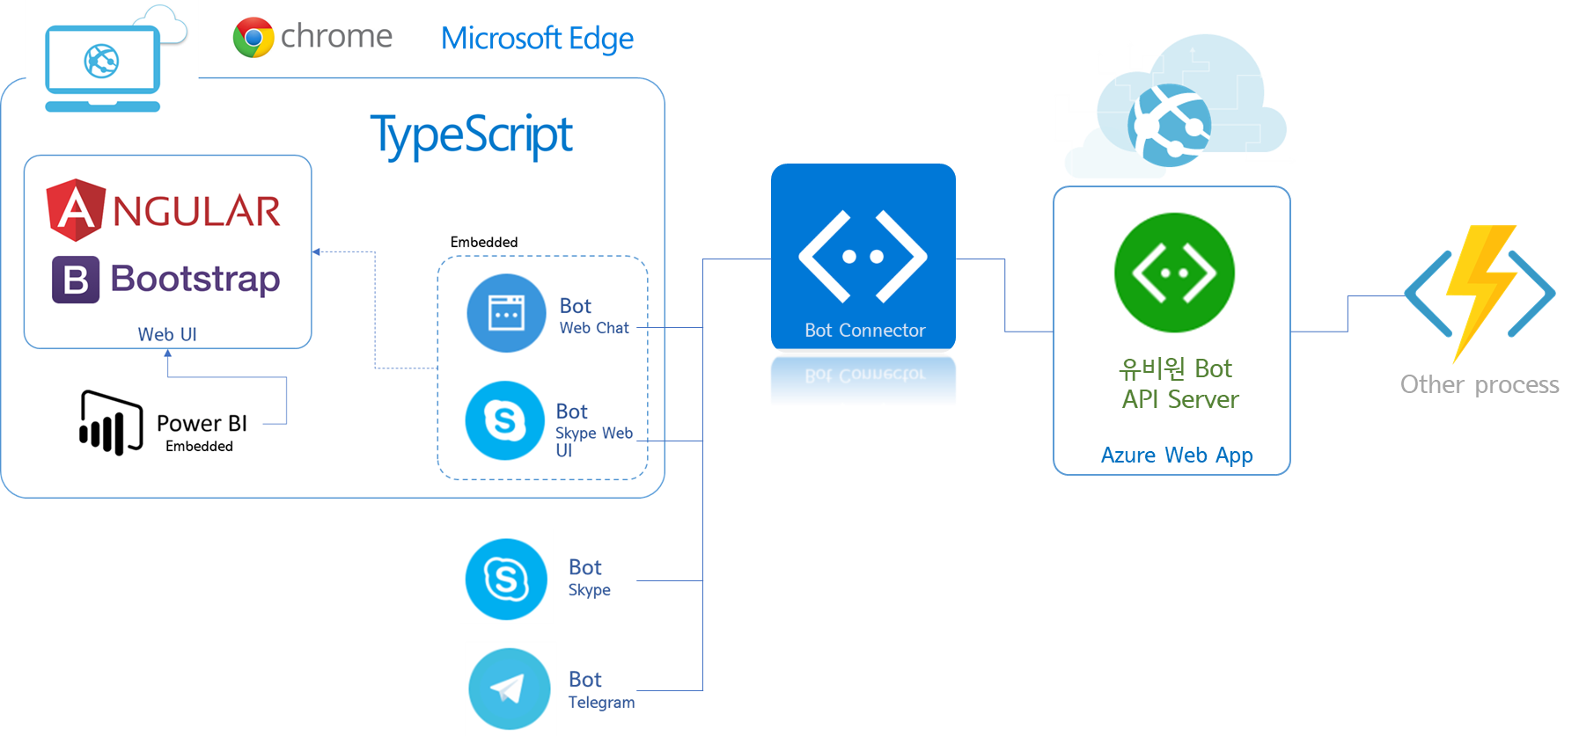

Angular 4 SPA Front-end UI
Web Site (Optional)
Front-end UI
Angular 4 SPA
Hosted on Azure Web App
Developed with TypeScript
Chat Bot embedded
Power BI embedded

Slide 26
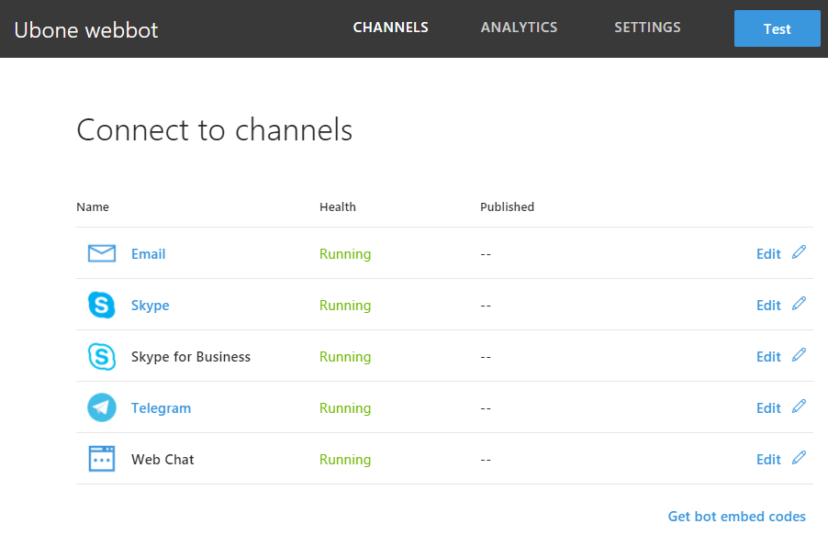
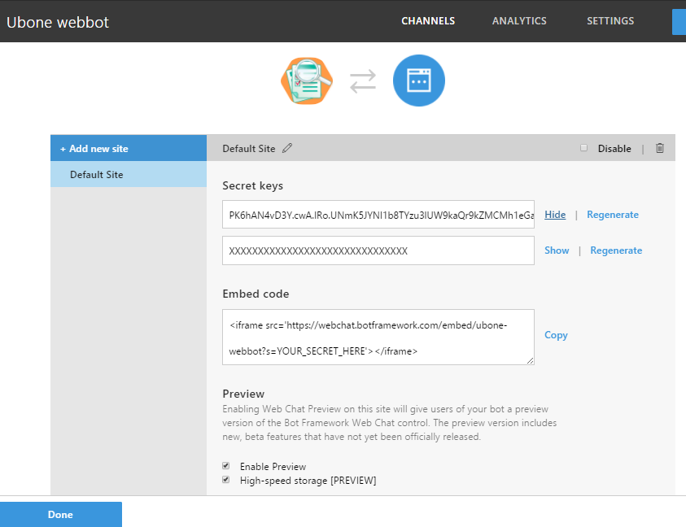
Bot Channels Configurations
<Code sample>
<iframe width="100%" height="500px" src='https://webchat.botframework.com/embed/ubone-webbot?s=PK6hAN4vD3Y.cwA.IRo.UNmK5JYNI1b8TYzu3lUW9kaQr9kZMCMh1eGau2S8We0'></iframe>

Slide 27
성지용 부장님 슬라이드

Slide 28







Oracle migration
Migrating data and schema from Oracle database into Azure SQL Databases
To-Be : Migrating from Oracle to Azure SQL DBs or Azure SQL Db for MySQL
Development Stage
Production Stage
Schema
Data
Conversion
Schema
Data

Slide 29
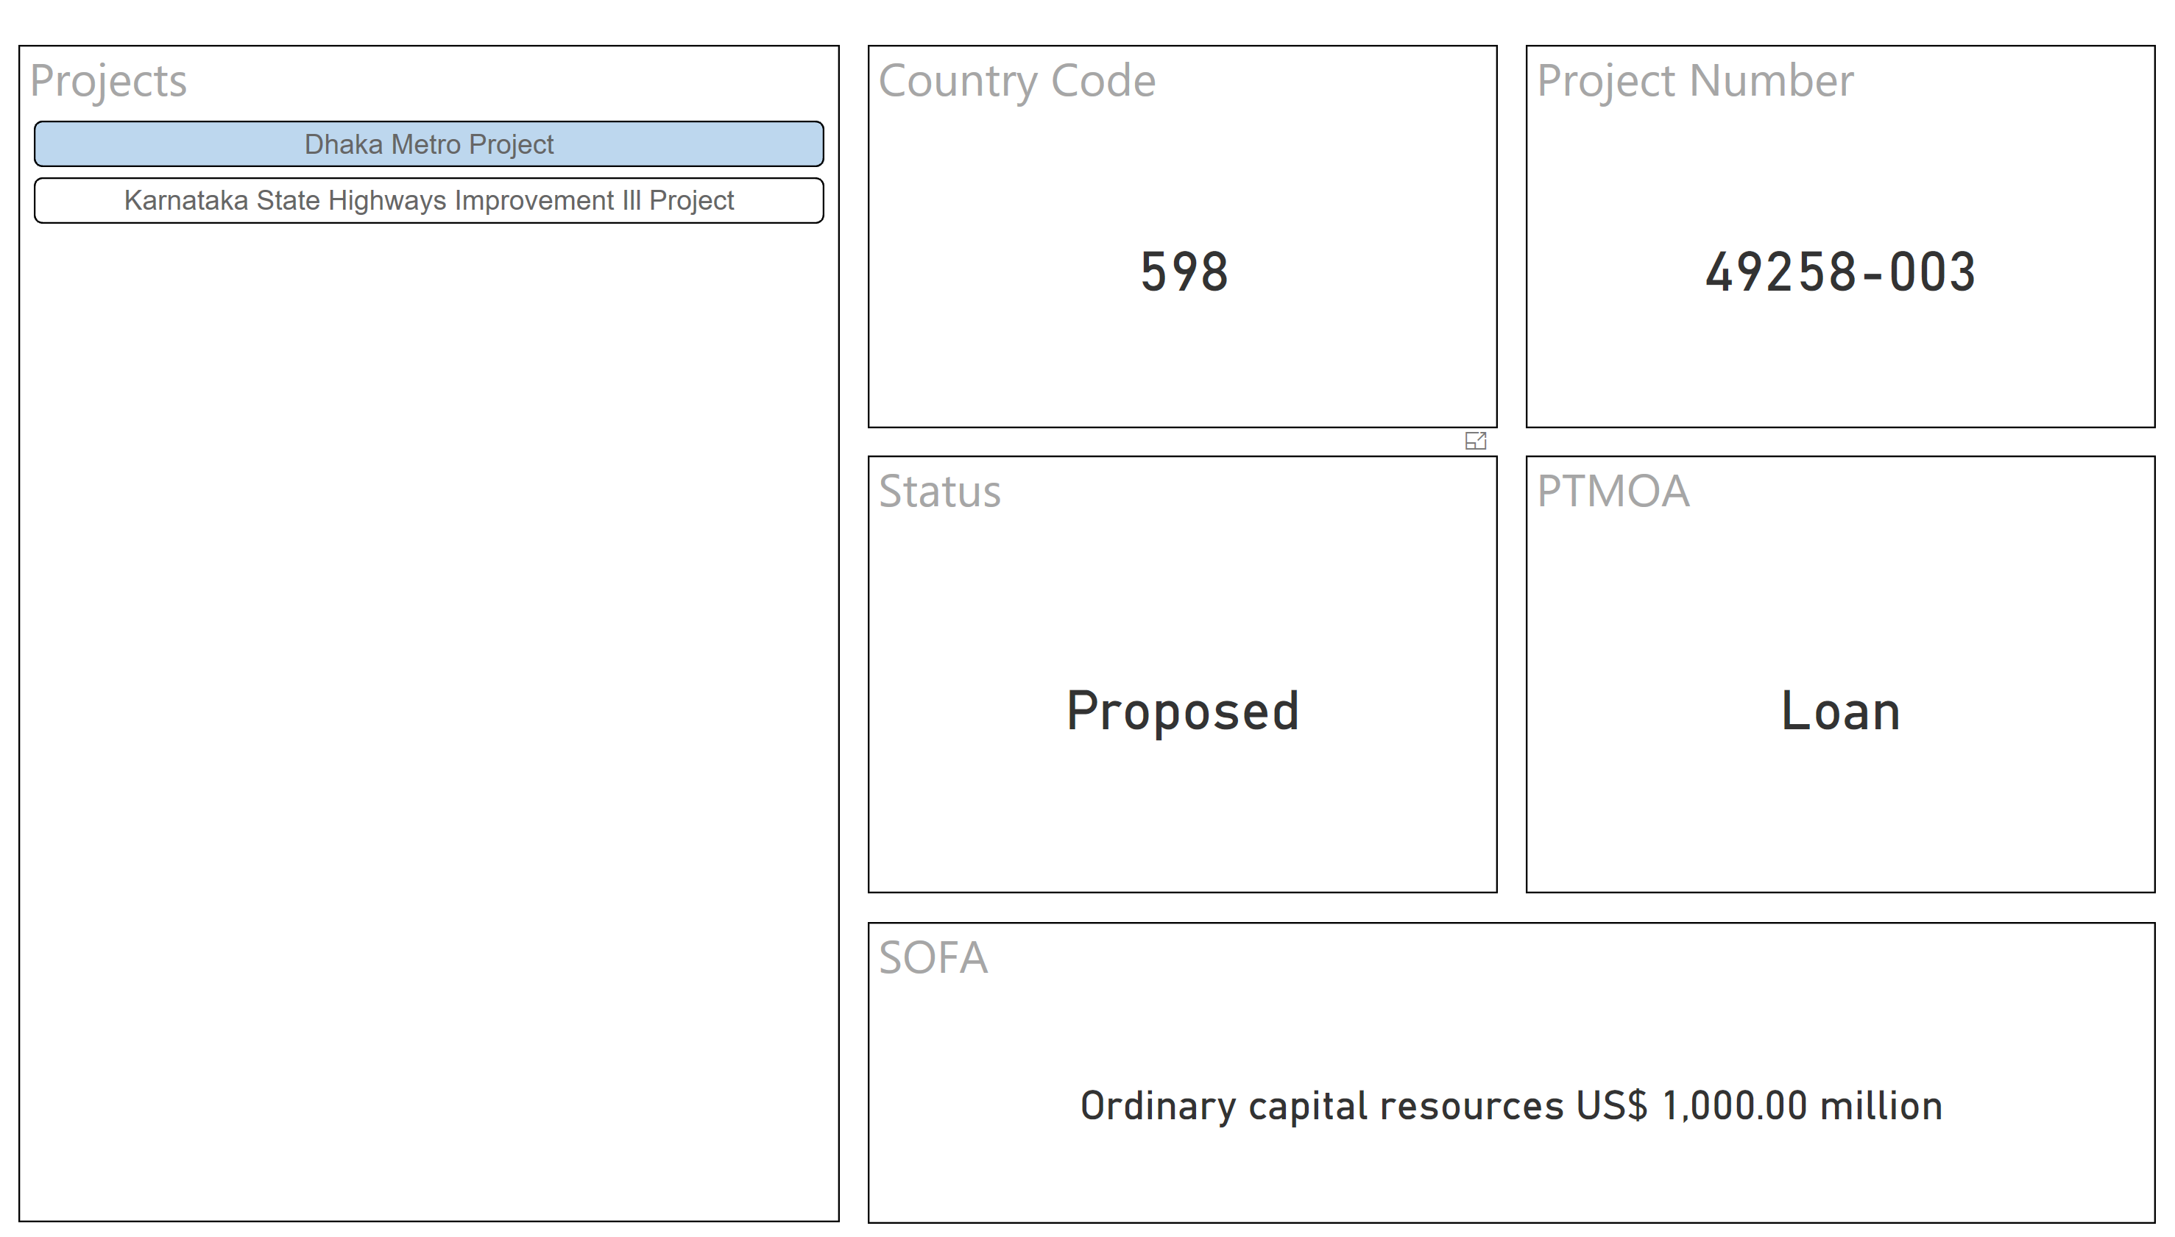
Power BI Report
Power BI report
is connected directly to Azure SQL Database using Direct Query
queries the underlying data source
Presenting data through diverse visualization components
Can be embedded to the existing web applications

Slide 30
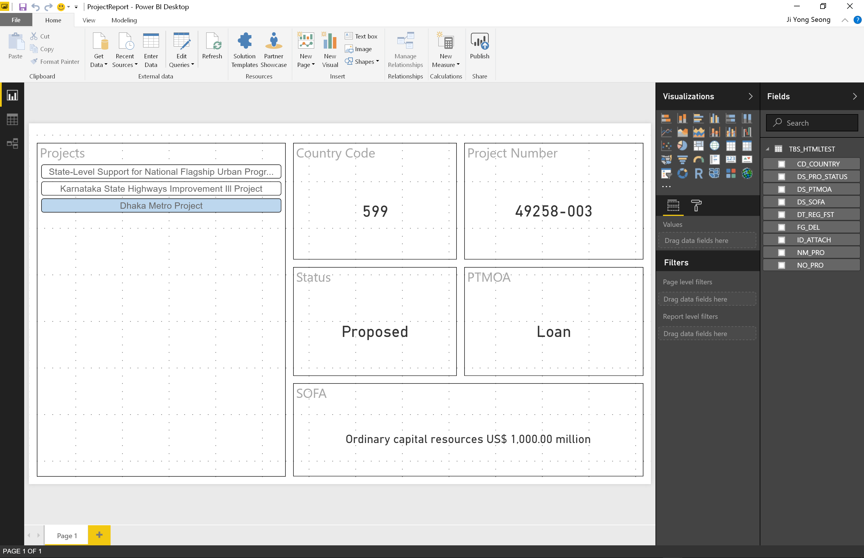

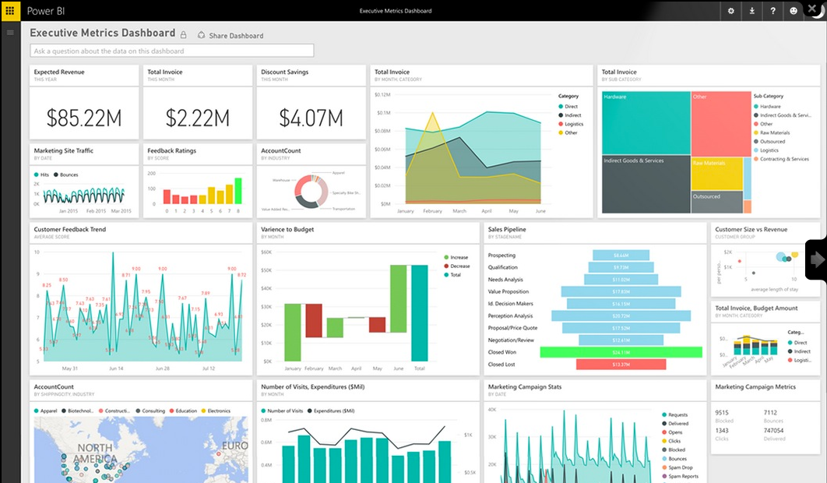
Power BI Report
Development (Power BI Desktop)
Azure SQL DB
To-Be : Power BI Embedded via REST, Power BI workspace
Auto Refresh
(15, 30 mins)
Power BI
Direct Query
Publish

Slide 31
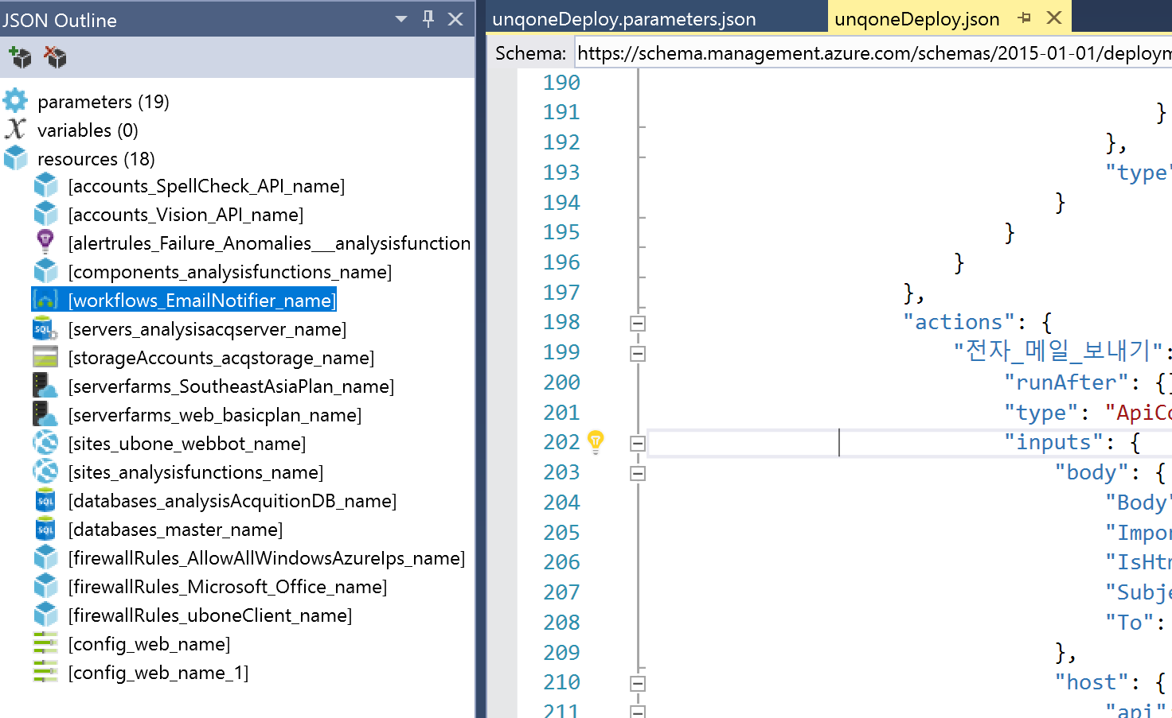
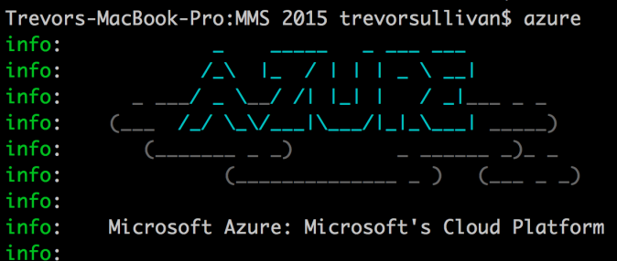

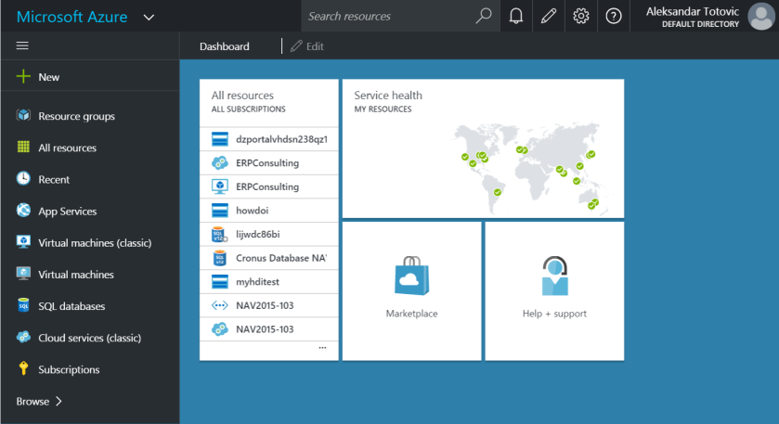
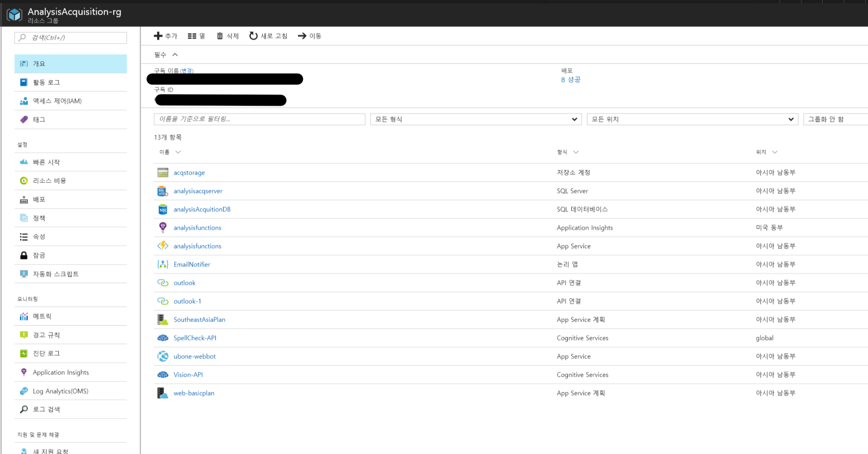
Azure Resource Templates
Azure Resource Templates
Is the definitions of Azure Resources
Reusable
Infrastructure as code
Declarative JSON format
To-Be : Automating deploying Azure resources
Deploy

Slide 32
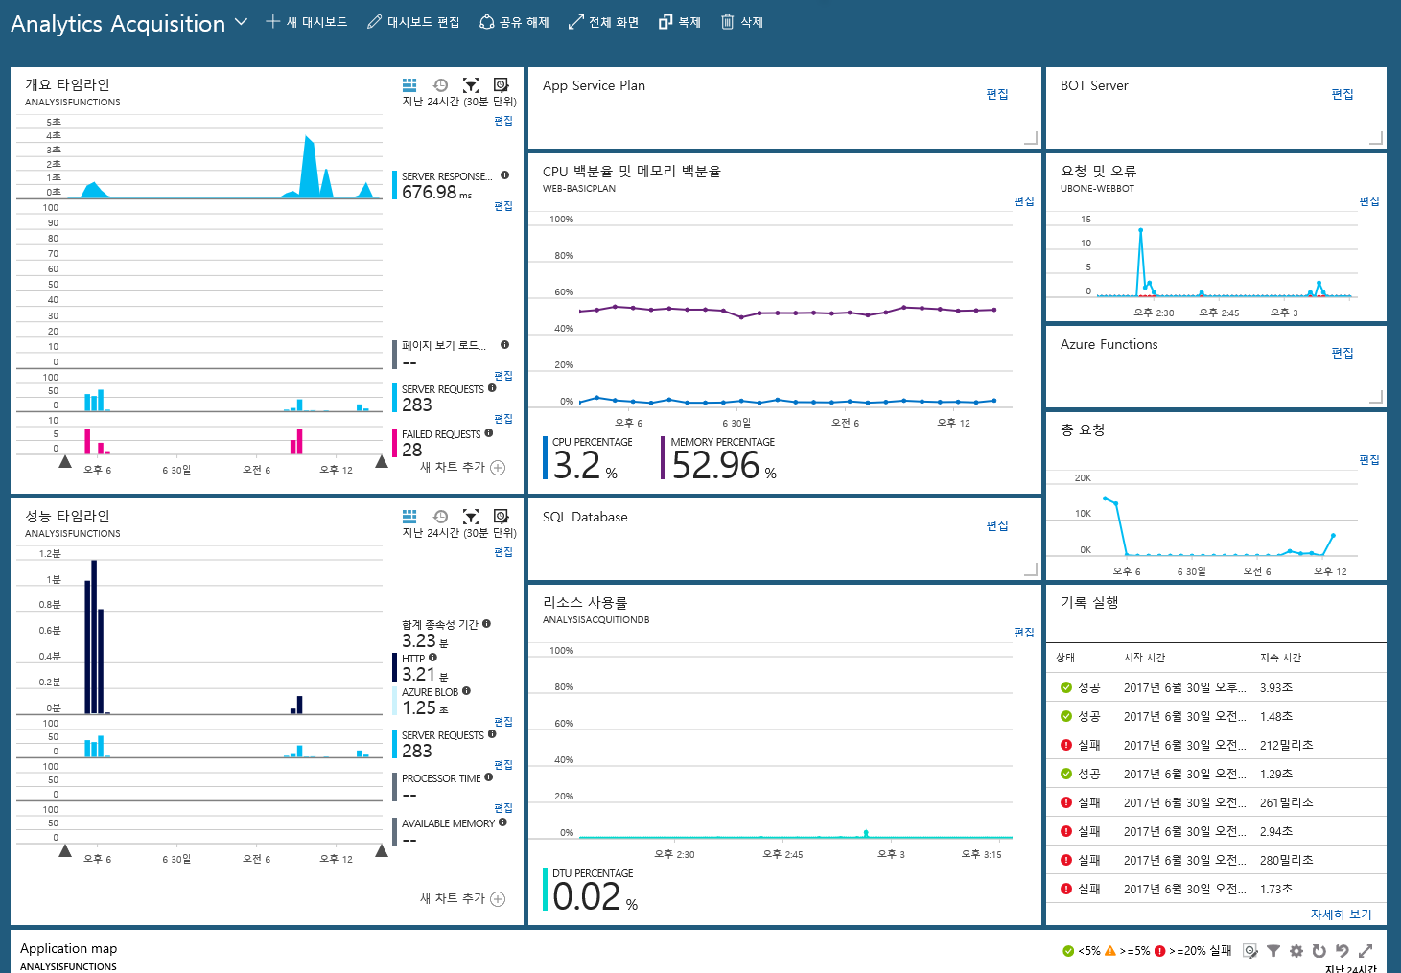
Azure App Insights
Application performance management
Interactive data analytics
Azure Diagnostics
Machine learning
DevOps integration
Get started quickly

Slide 33
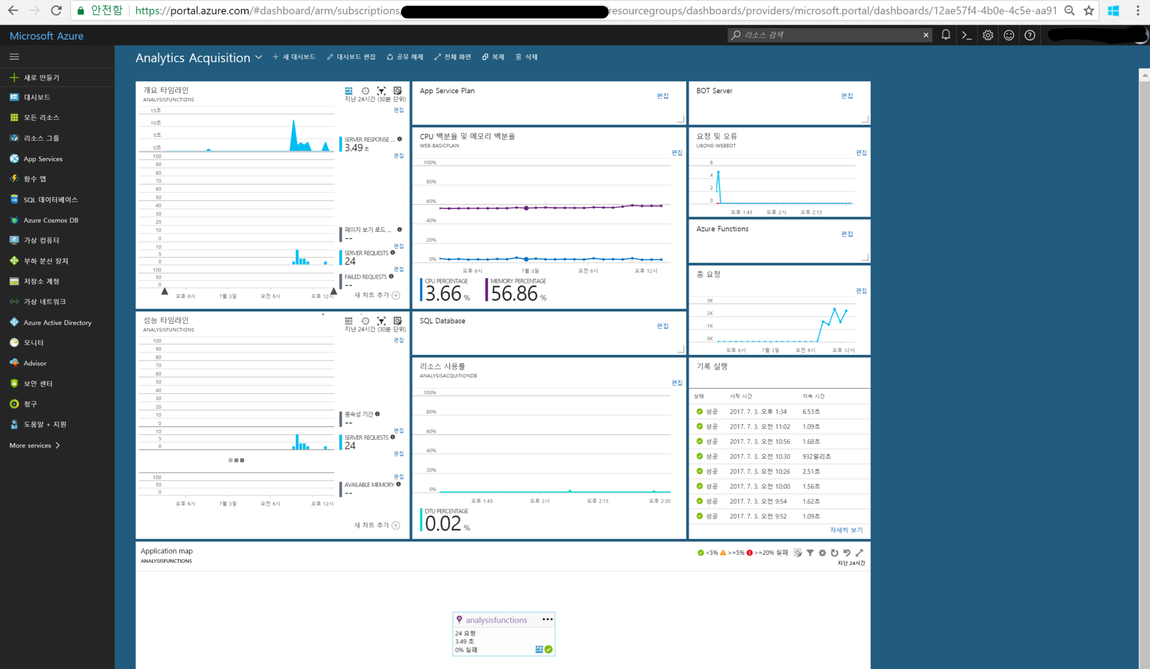
Azure Dashboard

Slide 34
감사합니다

